Slide 1
 | Metric | Rank
Distance | 0.55 mi | 3rd (Top X%)
Labels | 984 | 5th (Top Y%)
Accuracy | 91% | 4th (Top X%)
Missions Completed | 14 | 6th (Top X%)
Label Type | Count | Rated Correct | Rated Incorrect | Rated Unsure
Curb Ramp | 102 | XX/YY (X%) | XX/YY (X%) | XX/YY (X%)
Missing Curb Ramp | 98 | XX/YY (X%) | XX/YY (X%) | XX/YY (X%)
Obstacle in Path | 67 | XX/YY (X%) | XX/YY (X%) | XX/YY (X%)
Surface Problem | 140 | XX/YY (X%) | XX/YY (X%) | XX/YY (X%)
No Sidewalk | 130 | XX/YY (X%) | XX/YY (X%) | XX/YY (X%)
Total | 356 | XX/YY (y%) | XX/YY (y%) | XX/YY (y%)

Slide 2
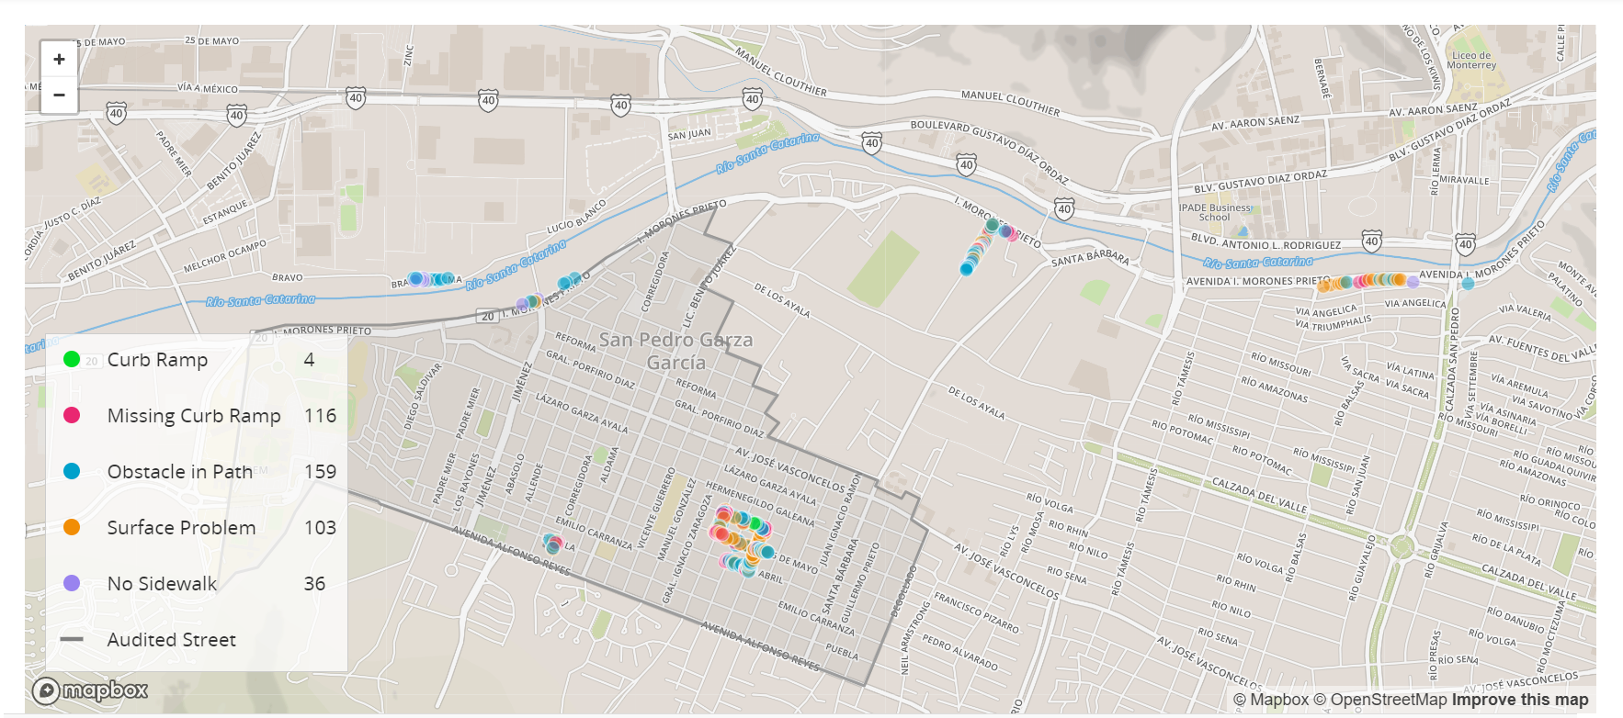




Your DISTANCE
Num Labels
Accuracy
missions
0.56 mi
984
86%
15
Notes:
https://thenounproject.com/search/?q=distance&i=2587675
https://thenounproject.com/search/?q=location+pin&i=2342268
https://thenounproject.com/search/?q=accuracy&i=3485590
https://thenounproject.com/search/?q=missions&i=2673795

Slide 3
Your DISTANCE
Num Labels
Accuracy
missions
Top 5%
0.56 mi
984
86%
15
Notes:
https://thenounproject.com/search/?q=distance&i=2587675
https://thenounproject.com/search/?q=location+pin&i=2342268
https://thenounproject.com/search/?q=accuracy&i=3485590
https://thenounproject.com/search/?q=missions&i=2673795

Slide 4
Your DISTANCE
Num Labels
Accuracy
missions
4th Place
0.56 mi
984
86%
15
Notes:
https://thenounproject.com/search/?q=distance&i=2587675
https://thenounproject.com/search/?q=location+pin&i=2342268
https://thenounproject.com/search/?q=accuracy&i=3485590
https://thenounproject.com/search/?q=missions&i=2673795

Slide 5

Your DISTANCE
Num Labels
Accuracy
missions
4th Place
0.56 mi
984
86%
15
Notes:
https://thenounproject.com/search/?q=distance&i=2587675
https://thenounproject.com/search/?q=location+pin&i=2342268
https://thenounproject.com/search/?q=accuracy&i=3485590
https://thenounproject.com/search/?q=missions&i=2673795
Actual flag that I used

Slide 6


Missions
Distance
Labels
Accuracy
Validations
4th Place
15
0.56 mi
984
86%
400
Notes:
https://thenounproject.com/search/?q=distance&i=2587675
https://thenounproject.com/search/?q=location+pin&i=2342268
https://thenounproject.com/search/?q=accuracy&i=3485590
https://thenounproject.com/search/?q=missions&i=2673795
Actual flag that I used in icon: https://thenounproject.com/search/?q=flag&i=1108961
Validation icon: https://thenounproject.com/search/?q=validation&i=1876484

Slide 7
Your Distance
Labels
Accuracy
Missions
4th Place
0.56 mi
984
86%
15
Notes:
https://thenounproject.com/search/?q=distance&i=2587675
https://thenounproject.com/search/?q=location+pin&i=2342268
https://thenounproject.com/search/?q=accuracy&i=3485590
https://thenounproject.com/search/?q=missions&i=2673795
Actual flag that I used in icon: https://thenounproject.com/search/?q=flag&i=1108961
Validation icon: https://thenounproject.com/search/?q=validation&i=1876484

Slide 8
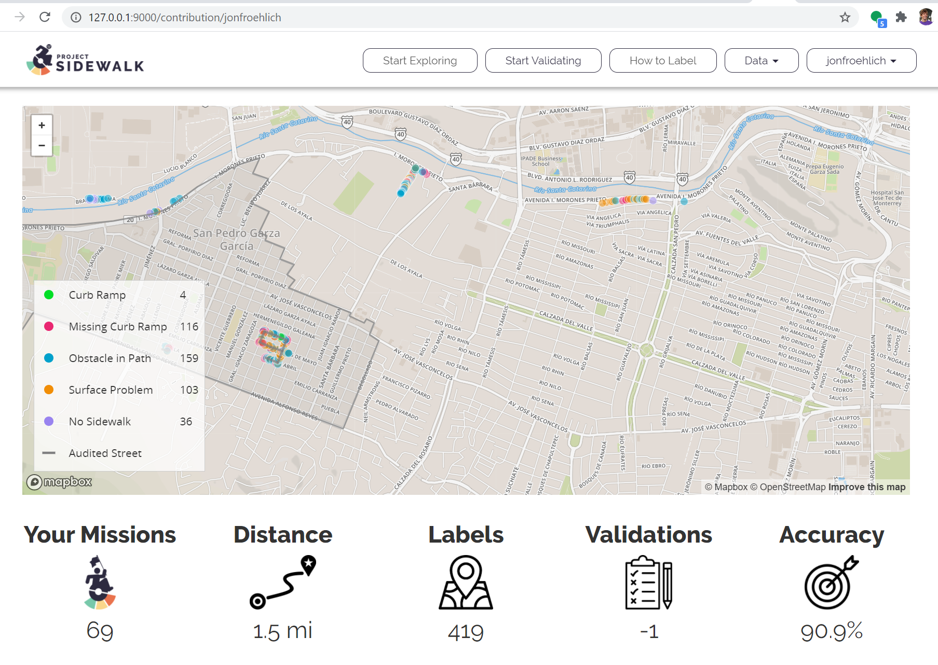


Achievements

Slide 9



1st
Achievements
Missions
Validations
Just 3 more missions until your next achievement!
223 more validations until your next achievement!

Slide 10
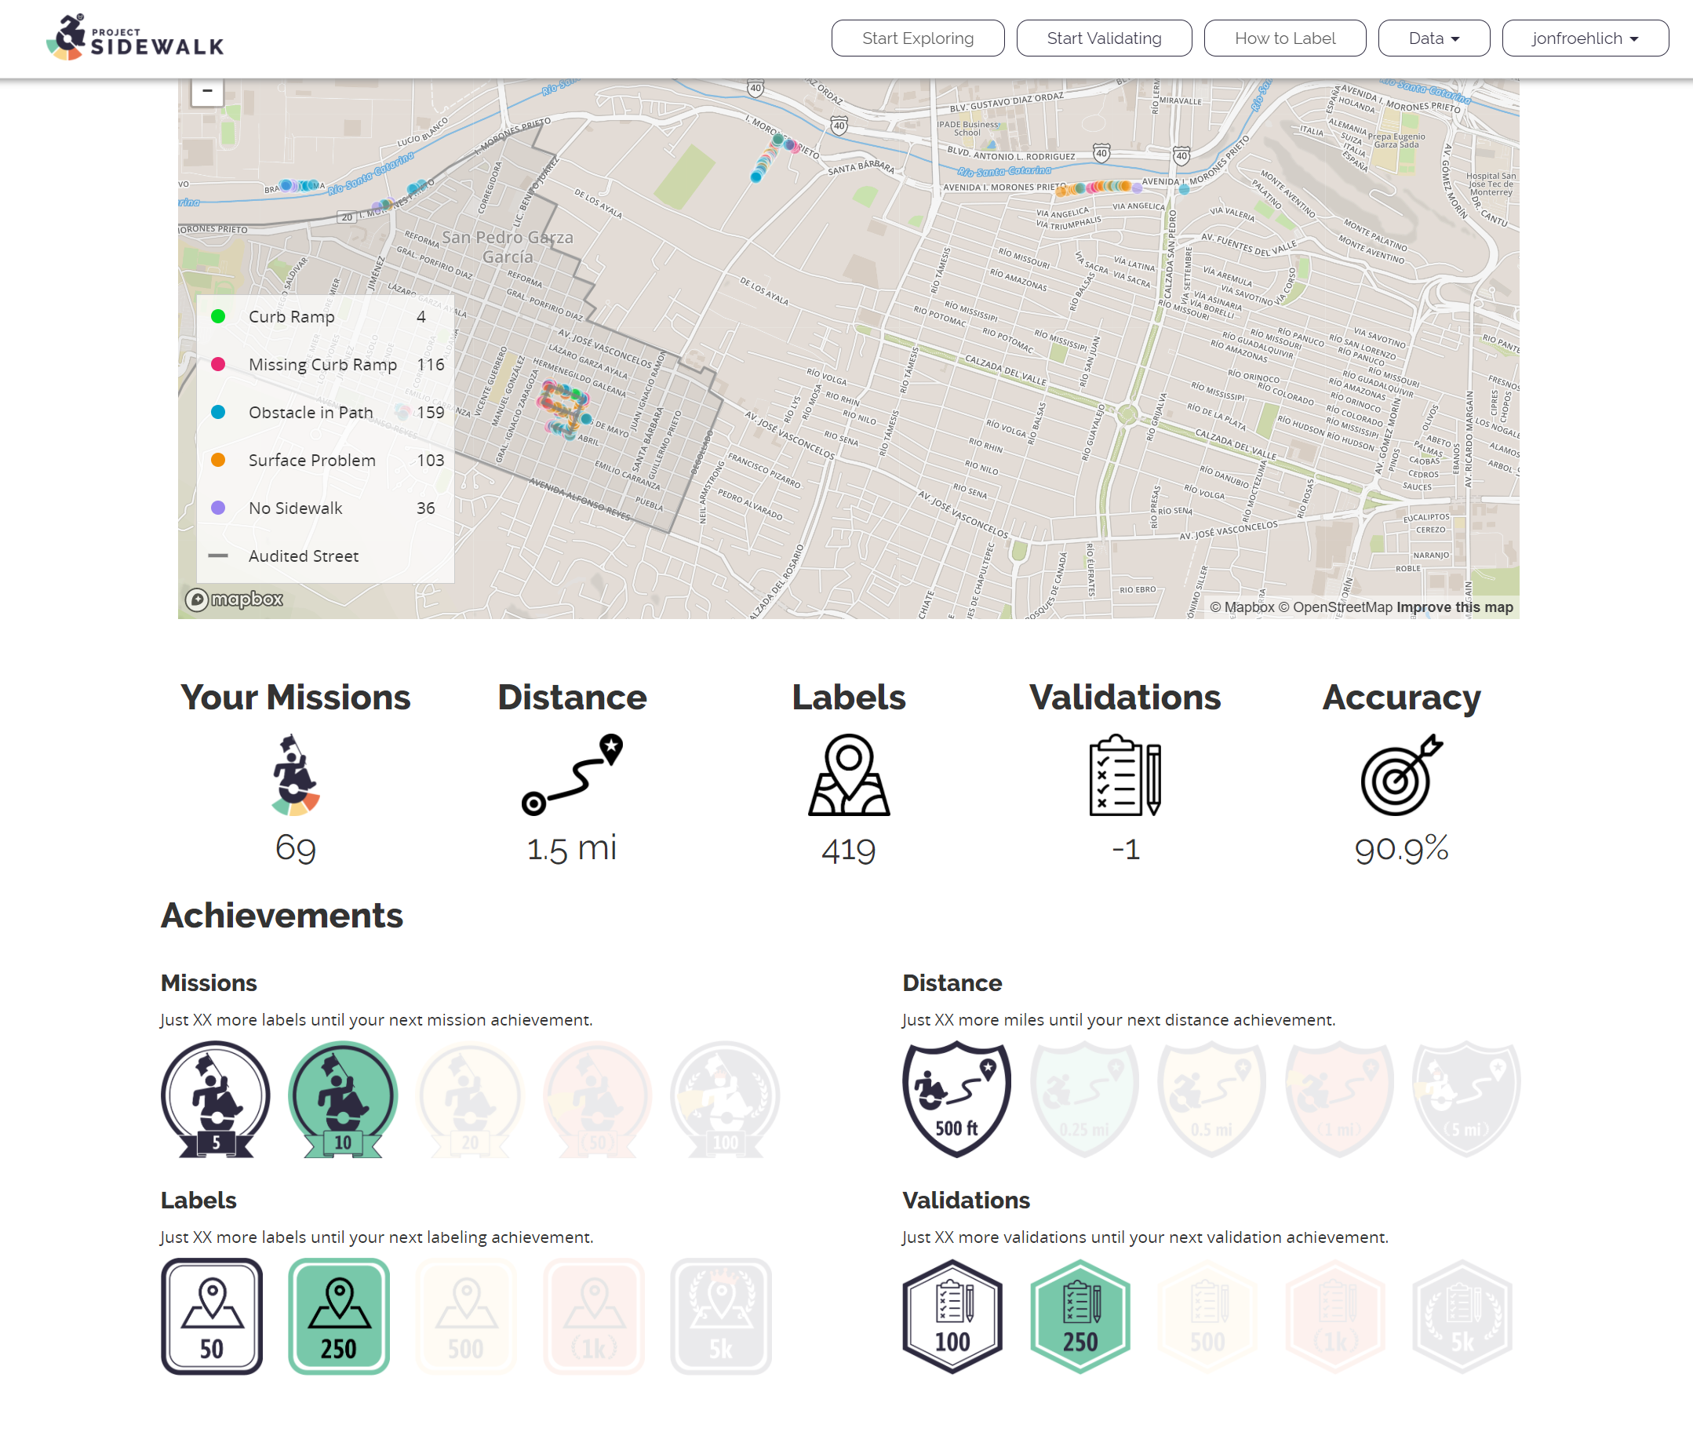


Missions
Distance
Distance
1st
3rd
3rd
Rank: 1st
Rank: 3rd
0.2 more miles to move up a position
Rank: 3rd
0.2 more miles to move up a position

Slide 11
Missions
Distance
Labels
Per neighborhood achievements?
Most labels per neighborhood?
Speed Trophy?
Can only be earned if accuracy > 80%
1st
3rd
3rd
Rank: 1st
Rank: 3rd
0.2 more miles to move up a position
Rank: 10+
44 more labels to move up a position

Slide 12
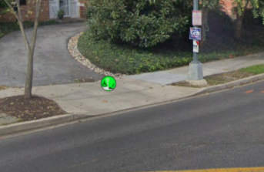
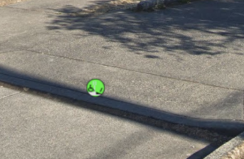
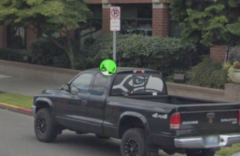
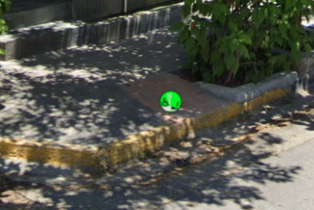
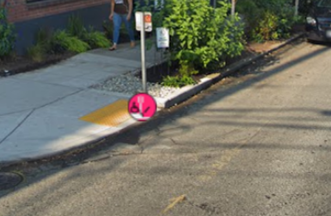
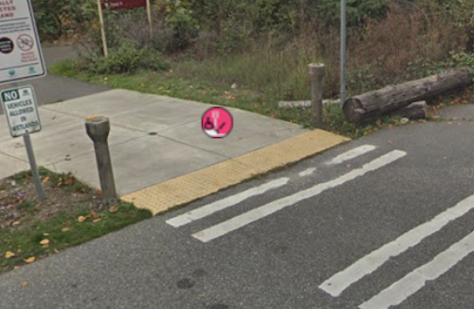
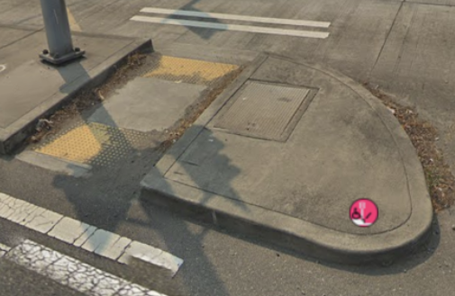
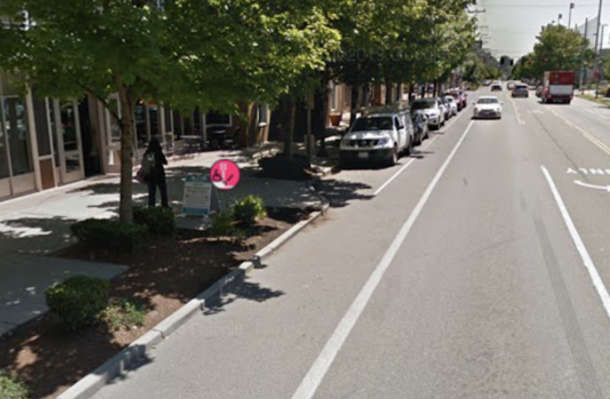
Your recent labels marked incorrect by other users
Your incorrect curb ramp labels
Your incorrect missing curb ramp labels

Slide 13
Your recently validated labels
These are your labels recently validated by other users. While other users can, of course, make mistakes. We’re showing them to you to help you learn and become a better labeler. You can also read our labeling guide here.
Correct curb ramp labels
Incorrect curb ramp labels
Your incorrect missing curb ramp labels

